Slide 1
Lecture 2
Euler’s method

Slide 2
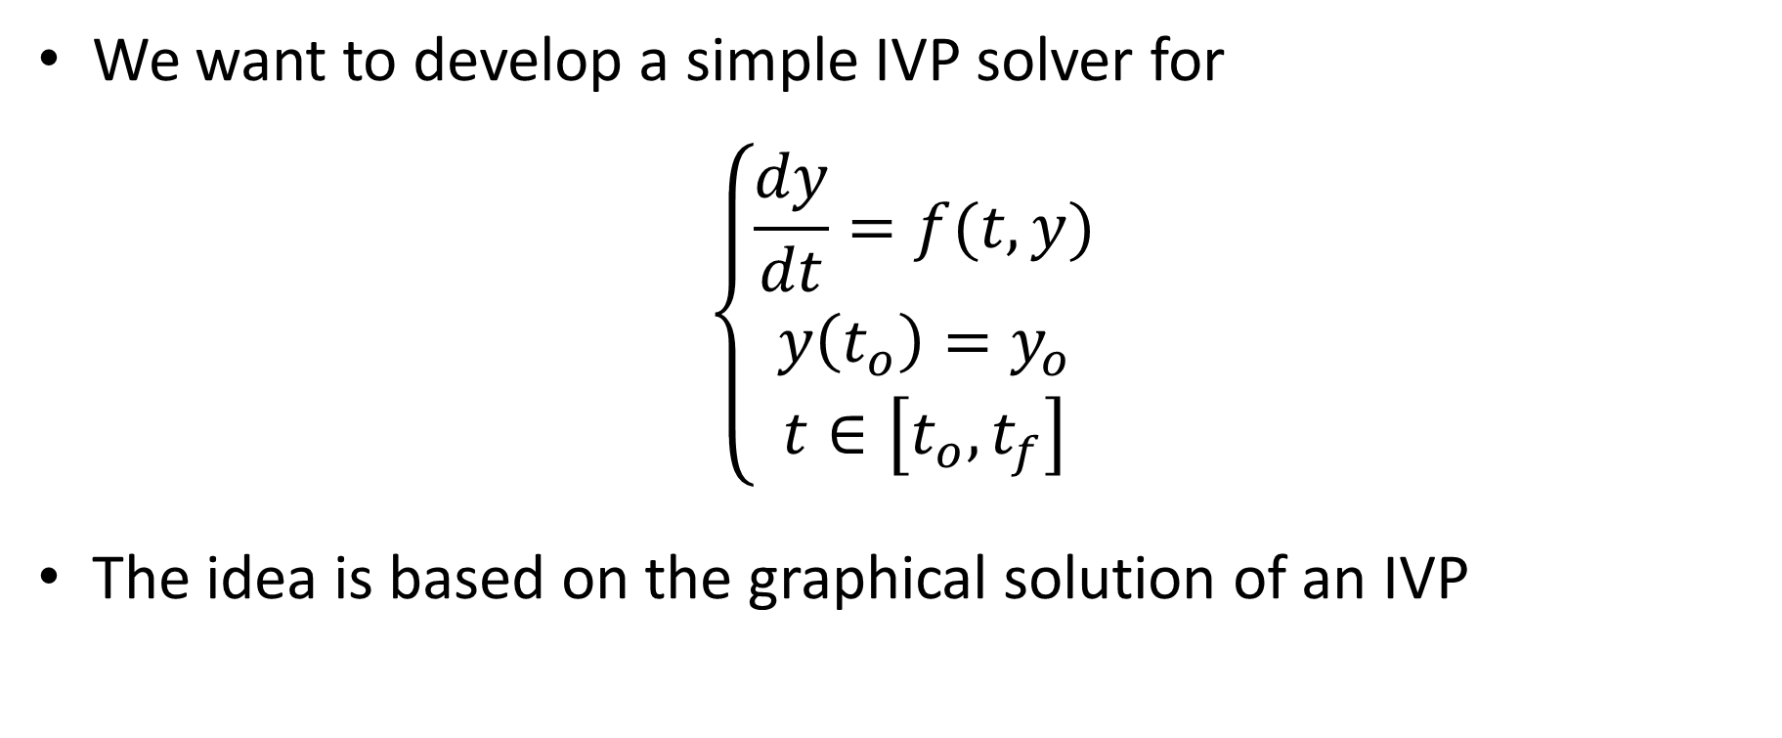
Introduction
We want to develop a simple IVP solver for
$$\left\{\begin{aligned}\frac{dy}{dt}=f(t,y) \\ y\left(t_{o}\right)=y_{o} \\ t∈\left[t_{o},t_{f}\right]\end{aligned}\right.$$
The idea is based on the graphical solution of an IVP
Notes:
In this lecture we will present a simple IVP solver known as Euler’s algorithm.
We will use this solver to learn several important aspects about IVP solvers. It is only later we will introduce more advanced solvers
Any IVP solver aims to solve an initial value problem.
We consider only problems which involve first order ordinary differential equations
The idea of Euler’s method will be based on the graphical solution technique we discussed in previous lecture

Slide 3





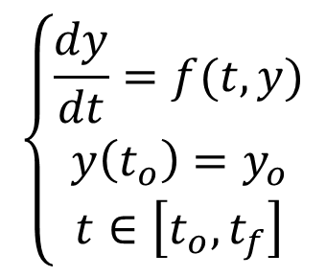





Overview of Euler’s Method
$$y$$
$$w_{i+1}$$
$$f(t_{i},w_{i})$$
$$hf(t_{i},w_{i})$$
$$\left\{\begin{aligned}\frac{dy}{dt}=f(t,y) \\ y\left(t_{o}\right)=y_{o} \\ t∈\left[t_{o},t_{f}\right]\end{aligned}\right.$$
$$w_{i}$$
$$w_{i+1}=w_{i}+hf\left(t_{i},w_{i}\right)$$
$$t_{i}$$
$$t_{i+1}$$
$$t$$
$$h$$
Notes:
Let us consider our IVP problem
The line on the (y,t) graph shows one of the solutions of the ordinary differential equation of the IVP
This solution was chosen to pass by the point (ti, wi).
wi is the approximation computed by the IVP solver in ti.
According the ODE we know that in this point the slope of this solution is f(ti, wi)
What Euler’s method does is to extrapolate linearly to ti+1, where ti+1 is ti plus the step size h.
This linear extrapolation is the approximation wi+1 in ti+1
It is simple to compute wi+1
First note that ti+1-ti is equal to h
Second wi+1-wi will be equal to h times f(ti,wi)
Consequently wi+1=wi+hf(ti,wi)
This equation is how Euler’s method computes an approximation in ti+1 from a an approximation in ti

Slide 4
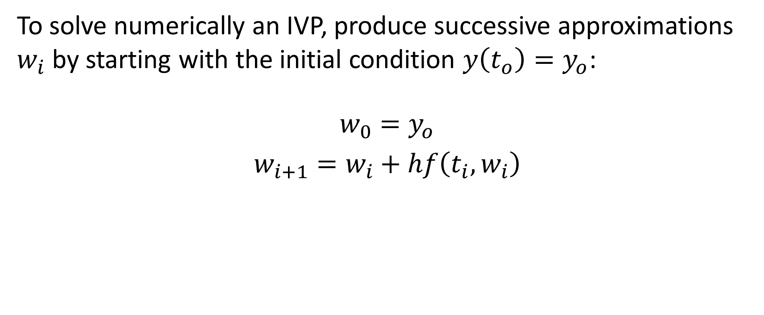
Euler’s method
To solve numerically an IVP, produce successive approximations $w_{i}$ by starting with the initial condition $y\left(t_{o}\right)=y_{o}$:
$${w_{0}=y_{o} \atop w_{i+1}=w_{i}+hf\left(t_{i},w_{i}\right)}$$
Notes:
To apply Euler’s method one has to start from an known value
Such a value is given by the initial condition
Consequently wo is equal to yo
Then one calculate w1 with Euler’s method by w1=wo+hf(to,wo)
From there one computes w2, w3 etc….
Generally wi+1=wi+hf(ti,wi)
I invite you to write down this algorithm on a paper as we will need it extensively in coming slides

Slide 5
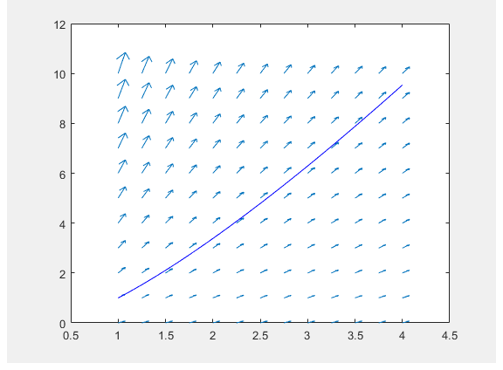
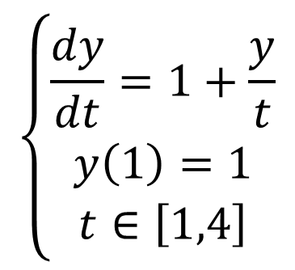
Example
$$\left\{\begin{aligned}\frac{dy}{dt}=1+\frac{y}{t} \\ y\left(1\right)=1 \\ t∈\left[1,4\right]\end{aligned}\right.$$
Notes:
Let us solve an IVP with Euler’s method
We consider the problem with the differential equation $\frac{dy}{dt}=1+\frac{y}{t}$ and initial condition y(1)=1
We want to solve it from t=1 to t=4
To start it is always highly recommended to solve the ODE graphically using slop fields as we discussed in pervious lecture
Based on the flow field plot one can evaluate qualitatively the shape of the solution y(t) of the IVP

Slide 6

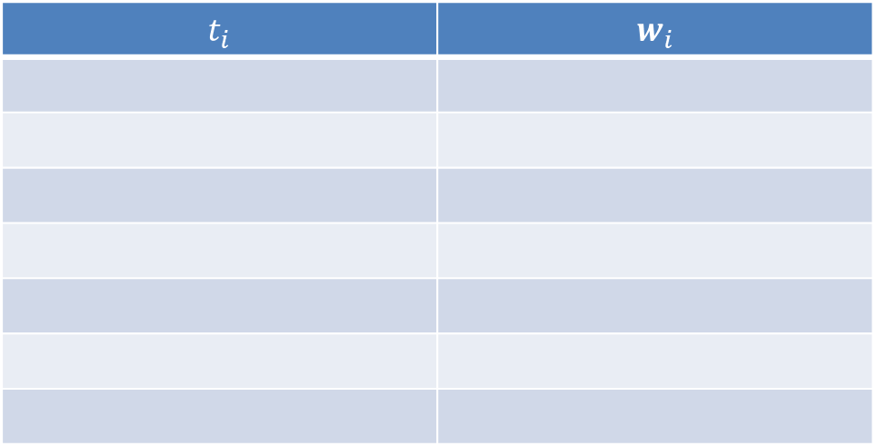
Example
We organize calculations in a table
$$t_{i}$$ | $$w_{i}$$
$$\left\{\begin{aligned}\frac{dy}{dt}=1+\frac{y}{t} \\ y\left(1\right)=1 \\ t∈\left[1,4\right]\end{aligned}\right.$$
Notes:
To organize our calculations we use a table
In the first column we write down the ti and in the second the corresponding approximations wi

Slide 7
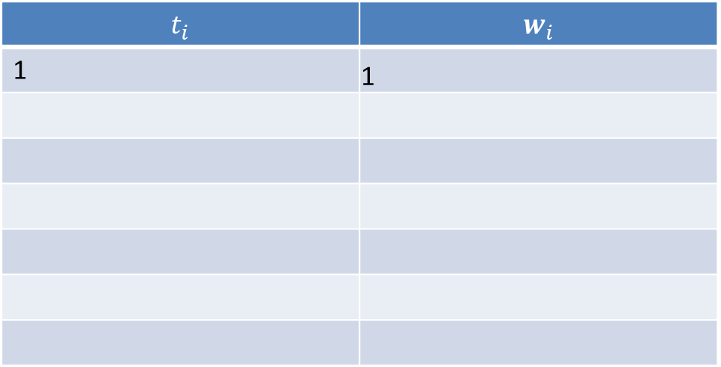
Example
We organize calculations in a table
$$t_{i}$$ | $$w_{i}$$
1 | 1
$$\left\{\begin{aligned}\frac{dy}{dt}=1+\frac{y}{t} \\ y\left(1\right)=1 \\ t∈\left[1,4\right]\end{aligned}\right.$$
Notes:
We start with the initial condition
to = 1 and wo = 1

Slide 8

Example
We choose $h=0.5$
$$t_{i}$$ | $$w_{i}$$
1 | 1
$$\left\{\begin{aligned}\frac{dy}{dt}=1+\frac{y}{t} \\ y\left(1\right)=1 \\ t∈\left[1,4\right]\end{aligned}\right.$$
Notes:
To continue the calculations we have to chose a value for the step size h
At this stage we can not yet explain how to chose appropriate values
We will learn progressively in the coming lectures how to do thus
For the moment let us use h=0.5

Slide 9
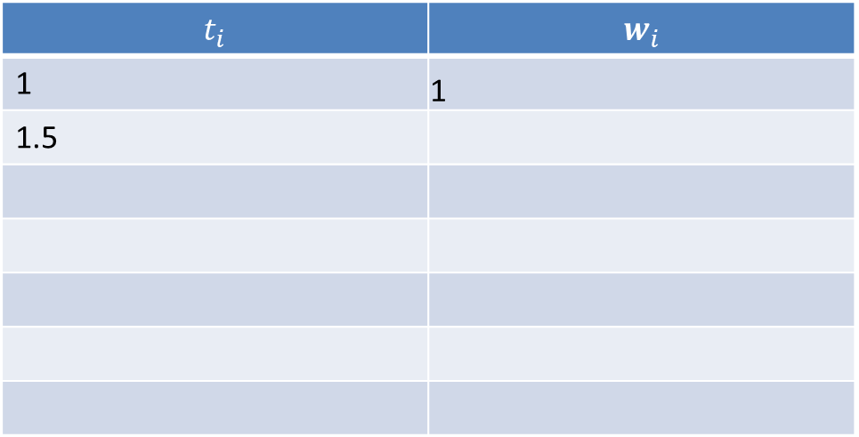
Example
We choose $h=0.5$
$$t_{i}$$ | $$w_{i}$$
1 | 1
1.5
$$\left\{\begin{aligned}\frac{dy}{dt}=1+\frac{y}{t} \\ y\left(1\right)=1 \\ t∈\left[1,4\right]\end{aligned}\right.$$
Notes:
If h=0.5, that means that 1 will be equal to 1+0.5=1.5

Slide 10
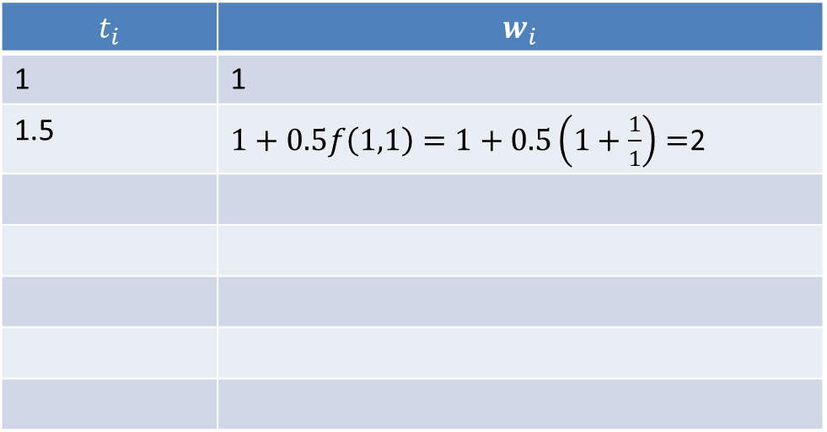
Example
We choose $h=0.5$
$$t_{i}$$ | $$w_{i}$$
1 | 1
1.5 | $1+0.5f\left(1,1\right)=1+0.5\left(1+\frac{1}{1}\right)=$2
$$\left\{\begin{aligned}\frac{dy}{dt}=1+\frac{y}{t} \\ y\left(1\right)=1 \\ t∈\left[1,4\right]\end{aligned}\right.$$
Notes:
To compute w1, we apply Euelr’s method
That is w1=1, which is wo, plus 0.5, which is h, times f evaluated in the previous point which is to=1 and wo=1
Conducting the calculation results in w1=2

Slide 11
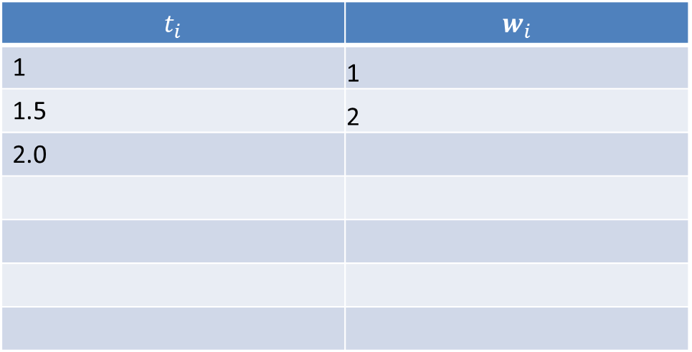
Example
We choose $h=0.5$
$$t_{i}$$ | $$w_{i}$$
1 | 1
1.5 | 2
2.0
$$\left\{\begin{aligned}\frac{dy}{dt}=1+\frac{y}{t} \\ y\left(1\right)=1 \\ t∈\left[1,4\right]\end{aligned}\right.$$
Notes:
t3 is then given by t2+h which is 1.5+0.5=2

Slide 12
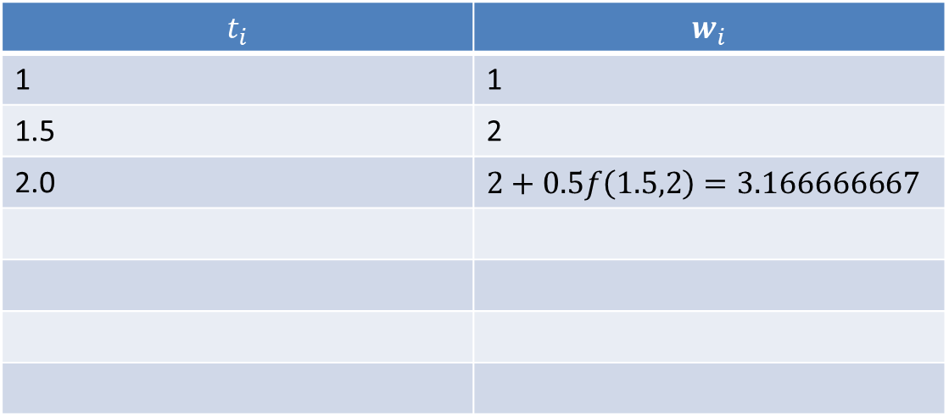
Example
We choose $h=0.5$
$$t_{i}$$ | $$w_{i}$$
1 | 1
1.5 | 2
2.0 | $$2+0.5f\left(1.5,2\right)=3.166666667$$
$$\left\{\begin{aligned}\frac{dy}{dt}=1+\frac{y}{t} \\ y\left(1\right)=1 \\ t∈\left[1,4\right]\end{aligned}\right.$$
Notes:
And as we did for w1, we compute w2 using Euler’s method
That is w2, which is 2, plus 0.5 times f evaluated in the previous point which is t1=1.5 and w1=2
After calculations we get w2 = $3.166666667$

Slide 13
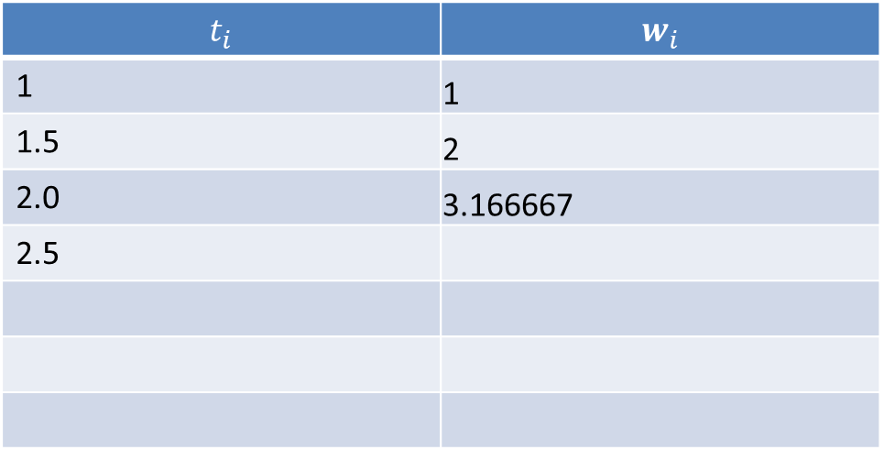
Example
We choose $h=0.5$
$$t_{i}$$ | $$w_{i}$$
1 | 1
1.5 | 2
2.0 | 3.166667
2.5
$$\left\{\begin{aligned}\frac{dy}{dt}=1+\frac{y}{t} \\ y\left(1\right)=1 \\ t∈\left[1,4\right]\end{aligned}\right.$$
Notes:
Next point would be for t3=2.5

Slide 14
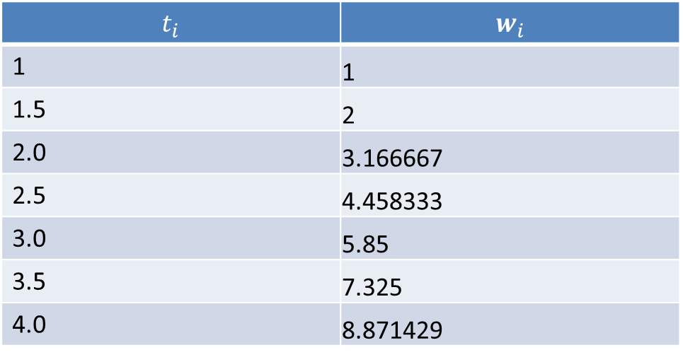
Example
We choose $h=0.5$
$$t_{i}$$ | $$w_{i}$$
1 | 1
1.5 | 2
2.0 | 3.166667
2.5 | 4.458333
3.0 | 5.85
3.5 | 7.325
4.0 | 8.871429
$$\left\{\begin{aligned}\frac{dy}{dt}=1+\frac{y}{t} \\ y\left(1\right)=1 \\ t∈\left[1,4\right]\end{aligned}\right.$$
Notes:
I invite you to try by yourself
The table displayed gives you the answer you should get

Slide 15

Example
Notes:
We can now plot the solution
The graph shows the slop field, together with the qualitative solution as a continuous blue line
We add now our approximations computed with Euler’s method
The approximations follow not too badly the qualitative solution form the slope field
But more precise answers are certainly desired
We will learn progressively how to produce more precise approxiamtions

Slide 16
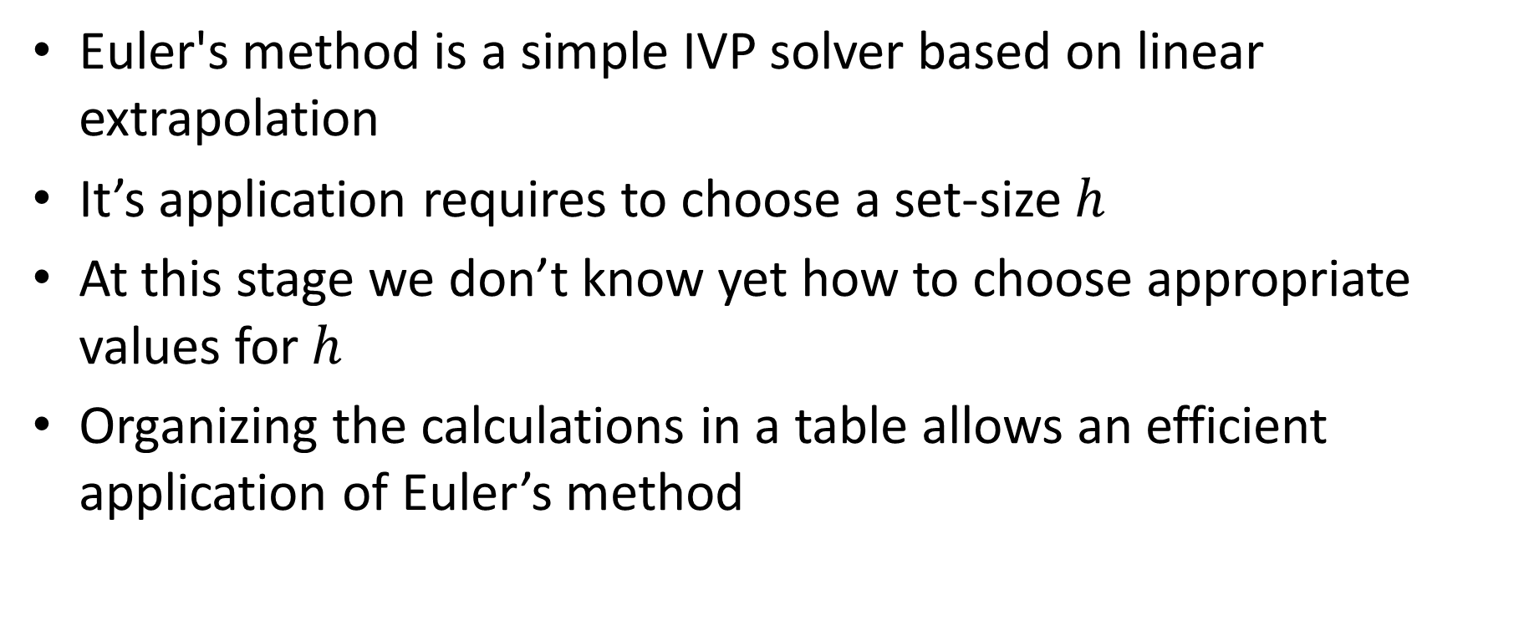
Summary
Euler's method is a simple IVP solver based on linear extrapolation
It’s application requires to choose a set-size $h$
At this stage we don’t know yet how to choose appropriate values for $h$
Organizing the calculations in a table allows an efficient application of Euler’s method
Notes:
Let us summarize the key findings
Euler's method is a simple IVP solver based on linear extrapolation
It’s application requires to choose a set-size $h$
At this stage we don’t know yet how to choose appropriate values for $h$
Organizing the calculations in a table allows an efficient application of Euler’s method

